Slide 1
Chapter 03:Boolean algebra and logic gates
Er. Hari K.C.
Department of software Engineering
Gandaki college of Engineering and science

Slide 2
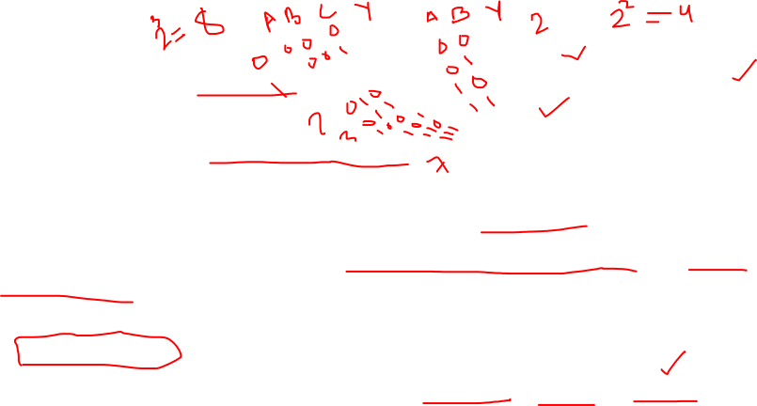
Definition of Logic Gates
LOGIC GATE
Output
Inputs
Logic gates are the block of hardware's that produces the certain output when input condition are satisfied.
Logic gates are the basic building blocks of any digital system.
It is an electronic circuit having one or more than one inputs and only one output.
The relationship between the input and the output is based on a certain logic.
Based on this, logic gates are named as AND gate, OR gate, NOT gate etc.

Slide 3
Truth Table
Truth table is the table that contains the inputs and outputs.
The outputs is the possible combination of all inputs.
A truth table is a tabular representation of all the combinations of values for inputs and their corresponding outputs.
It is a mathematical table that shows all possible outcomes that would occur from all possible scenarios that are considered factual, hence the name.
Truth tables are usually used for logic problems as in Boolean algebra and electronic circuits.

Slide 4
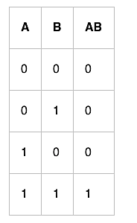
Example of Truth Table
A truth table shows the results of a logical expression, with individual columns for each involved variable, and a column for their corresponding outcomes.
All variations of the inputs or arguments are listed to the left, while the output is usually placed in the last columns to the right.

Slide 5
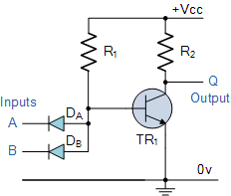
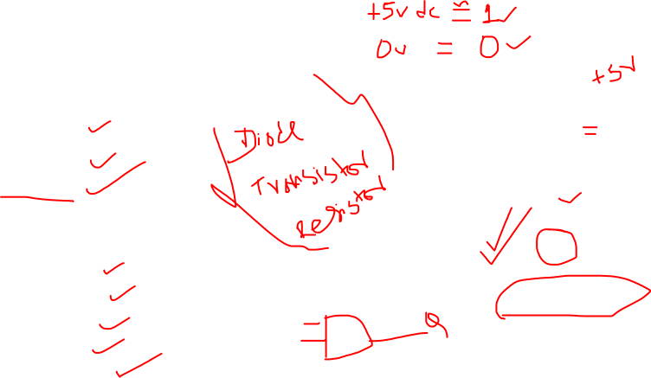
Types of logic gates
Basic gates
NOT gate
And gate
OR gate
Derrived gates
- Buffer gate
NAND gate
NOR gate
XOR gate
X-NOR gate
Two Input AND gate

Slide 6
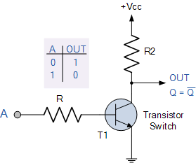

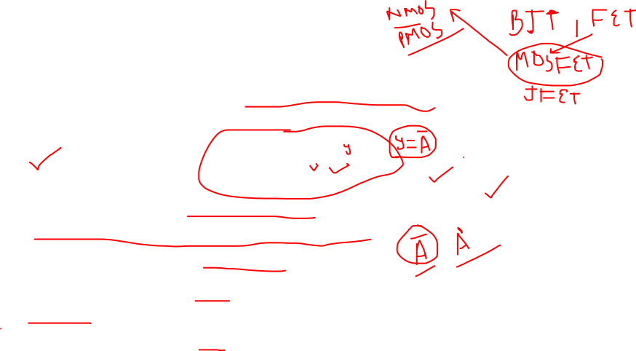
Basic gate
Basic logic gates are those gates that are made of basic circuits.
Logic gates are made of transistors and resistors.
NOT gate
The NOT gate is an electronic circuit that produces an inverted version of the input at its output.
It is also known as an inverter.
If the input variable is A, the inverted output is known as NOT A.
This is also shown as A', or A with a bar over the top, as shown at the outputs.

Slide 7
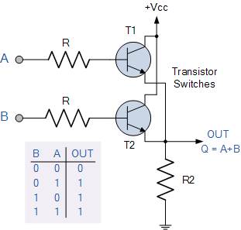
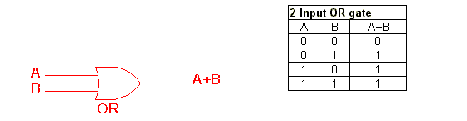
OR gate
The OR gate is an electronic circuit that gives a high output (1) if one or more of its inputs are high.
A plus (+) is used to show the OR operation.
It perform logical addition .

Slide 8
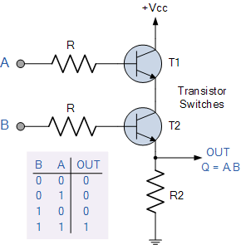
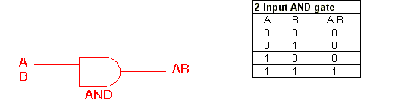
AND gate
The AND gate is an electronic circuit that gives a high output (1) only if all its inputs are high.
It perform logical multiplication.
A dot (.) is used to show the AND operation . i.e. A.B.
Bear in mind that this dot is sometimes omitted i.e. AB

Slide 9
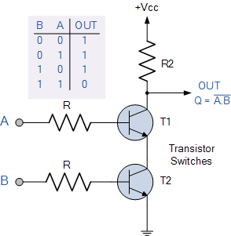



Derrived logic gates
NAND gate:
It is the combination of NOT gate and AND gate.

Slide 10


Symbol | Truth Table
2-input NAND Gate | B | A | Q
 | 0 | 0 | 1
 | 0 | 1 | 1
 | 1 | 0 | 1
 | 1 | 1 | 0
Boolean Expression Q = A.B | Read as A AND B gives NOT Q
Symbol | Truth Table
3-input NAND Gate | C | B | A | Q
 | 0 | 0 | 0 | 1
 | 0 | 0 | 1 | 1
 | 0 | 1 | 0 | 1
 | 0 | 1 | 1 | 1
 | 1 | 0 | 0 | 1
 | 1 | 0 | 1 | 1
 | 1 | 1 | 0 | 1
 | 1 | 1 | 1 | 0
Boolean Expression Q = A.B.C | Read as A AND B AND C gives NOT Q
The NAND (Not – AND) gate has an output that is normally at logic level “1” and only goes “LOW” to logic level “0”
when ALL of its inputs are at logic level “1”. The Logic NAND Gate is the reverse or “Complementary” form of the AND gate

Slide 11

NOR logic gate
The inclusive NOR (Not-OR) gate has an output that is normally at logic level “1” and only goes “LOW” to logic level “0” when ANY of its inputs are at logic level “1”.
The Logic NOR Gate is the reverse or “Complementary” form of the inclusive OR gate .

Slide 12
The logic or Boolean expression given for a logic NOR gate is that for Logical Multiplication which it performs on the complements of the inputs.
The Boolean expression for a logic NOR gate is denoted by a plus sign, ( + ) with a line or Overline, ( ‾‾ ) over the expression to signify the NOT or logical negation of the NOR gate giving us the Boolean expression of: A+B = Q.
Then we can define the operation of a 2-input digital logic NOR gate as being:
“If both A and B are NOT true, then Q is true”

Slide 13
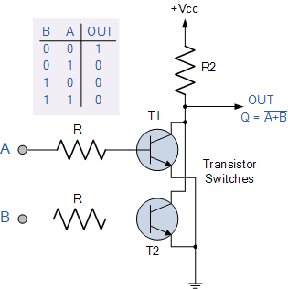

Symbol | Truth Table
2-input NOR Gate | B | A | Q
 | 0 | 0 | 1
 | 0 | 1 | 0
 | 1 | 0 | 0
 | 1 | 1 | 0
Boolean Expression Q = A+B | Read as A OR B gives NOT Q

Slide 14
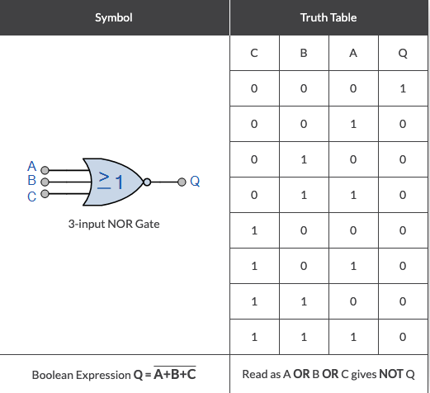

3 inputs – A,B,C
Outputs - Q
Boolean expression Q = (A+B+C)’
The output is high when all inputs are low
Otherwise output is low.

Slide 15
Universal Gate
Individual logic gates can be connected together to form a variety of different switching functions and combinational logic circuits.
Universal logic gates are the logic gates that can be used to perform the function of basic gates.
NAND logic gate and NOR logic gate are universal logic gates.
A universal gate is a gate which can implement any Boolean function without need to use any other gate type.
In practice, this is advantageous since NAND and NOR gates are economical and easier to fabricate and are the basic gates used in all IC digital logic families.

Slide 16
NAND gate as Universal Gate
To prove that any Boolean function can be implemented using only NAND gates,
we will show that the AND, OR, and NOT operations can be performed using only NAND gates.
Implementing an Inverter Using only NAND Gate.
Implementing AND Using only NAND Gates .
Implementing OR Using only NAND Gates.

Slide 17


NAND gate as NOT gate
All NAND input pins connect to the input signal A gives an output A’.
One NAND input pin is connected to the input signal A while all other input pins are connected to logic 1. The output will be A’.

Slide 18

2.NAND gate as AND gate
An AND gate can be replaced by NAND gates as shown in the figure.
(The AND is replaced by a NAND gate with its output complemented by a NAND gate inverter).

Slide 19
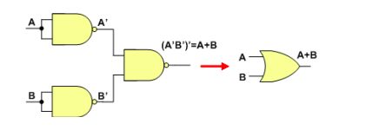
NAND gate as OR gate
An OR gate can be replaced by NAND gates as shown in the figure
(The OR gate is replaced by a NAND gate with all its inputs complemented by NAND gate inverters).
Thus, the NAND gate is a universal gate since it can implement the AND, OR and NOT functions.

Slide 20


NOR gate as Universal gate 1) NOR gate as NOT gate
All NOR input pins connect to the input signal A gives an output A’.
One NOR input pin is connected to the input signal A while all other input pins are connected to logic 0. The output will be A’.

Slide 21

2.NOR gate as OR gate
An OR gate can be replaced by NOR gates as shown in the figure.
(The OR is replaced by a NOR gate with its output complemented by a NOR gate inverter)

Slide 22
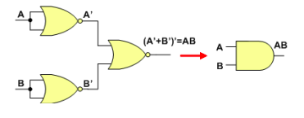
3.NOR gate as AND gate
An AND gate can be replaced by NOR gates as shown in the figure
(The AND gate is replaced by a NOR gate with all its inputs complemented by NOR gate inverters)

Slide 23
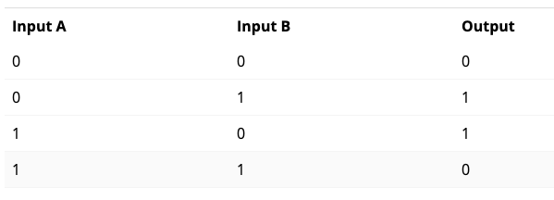
Exclusive OR gate(XOR)
There are two remaining gates of the primary electronics logic gates: XOR, which stands for Exclusive OR, and XNOR, which stands for Exclusive NOR.
In an XOR gate, the output is HIGH if one, and only one, of the inputs is HIGH. If both inputs are LOW or both are LOW, the output is LOW.

Slide 24
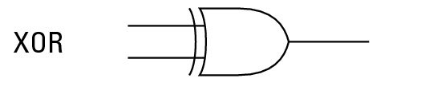
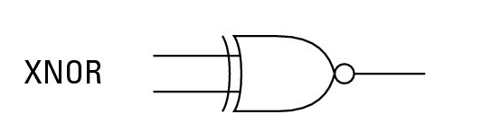

Slide 25
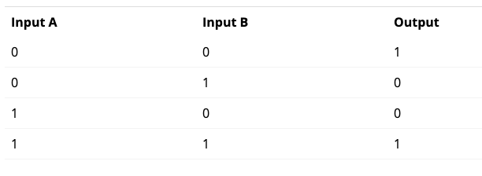
XNOR gate
The XOR gate has a lesser-known cousin called the XNOR gate.
An XNOR gate is an XOR gate whose output is inverted.

Slide 26
Factors to be considered for logic gates
the feasibility and economy of producing the gate with physical components
the possibility of extending the gate to more than two inputs.
the basic properties of the binary operator such as commutative and associative.
the ability of the gate to implement Boolean functions.

Slide 27
Boolean Alzebra
Boolean Algebra is used to analyze and simplify the digital (logic) circuits.
It uses only the binary numbers i.e. 0 and 1. It is also called as Binary Algebra or logical Algebra.
Boolean algebra was invented by George Boole in 1854.
Later it was modified by Shannon in 1938 and by Huntington in 1904.

Slide 28
Rule in Boolean Algebra
Following are the important rules used in Boolean algebra.
Variable used can have only two values. Binary 1 for HIGH and Binary 0 for LOW.
Complement of a variable is represented by an overbar or Single quote.
Thus, complement of variable B is represented as B’
Thus if B = 0 then B’ = 1 and B = 1 then B’ = 0.
OR ing of the variables is represented by a plus (+) sign between them.
For example ORing of A, B, C is represented as A + B + C.
Logical ANDing of the two or more variable is represented by writing a dot between them such as A.B.C.
Sometime the dot may be omitted like ABC.

Slide 29
Boolean Laws
There are six types of Boolean Laws.
Commutative law
Any binary operation which satisfies the following expression is referred to as commutative operation.
Commutative law states that changing the sequence of the variables does not have any effect on the output of a logic circuit.

Slide 30
Associative law
This law states that the order in which the logic operations are performed is irrelevant as their effect is the same.
Distributive law
Distributive law states the following condition.
AND law
These laws use the AND operation. Therefore they are called as AND laws.

Slide 31


OR law
These laws use the OR operation. Therefore they are called as OR laws.
INVERSION law
This law uses the NOT operation.
The inversion law states that double inversion of a variable results in the original variable itself.
e.g:

Slide 32
De-Morgan’s Theorem
De Morgan has suggested two theorems which are extremely useful in Boolean Algebra.
DeMorgan’s Theorem is a rule for Boolean expressions, declaring how long complementation “bars” are to be broken into shorter bars
The two theorems are discussed below.
Theorem 1: The complement of a product of variables is equal to the sum of the complements of the variables,
The left hand side (LHS) of this theorem represents a NAND gate with inputs A and B, whereas the right hand side (RHS) of the theorem represents an OR gate with inverted inputs.

Slide 33
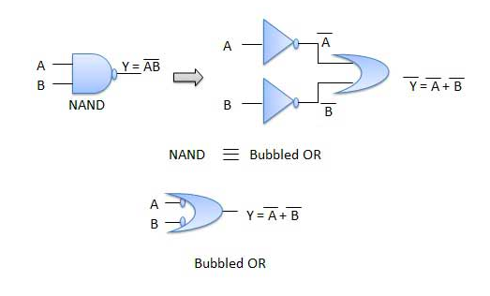
This OR gate is called as Bubbled OR.

Slide 34
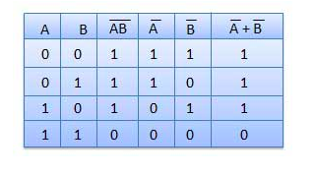
Table showing verification of the De Morgan's first theorem −

Slide 35
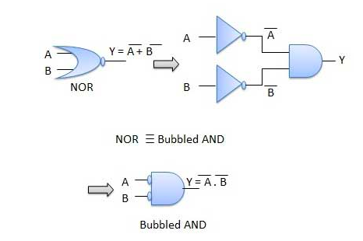
Theorem 2:The complement of a sum of variables is equal to the product of the complements of the variables.
The LHS of this theorem represents a NOR gate with inputs A and B, whereas the RHS represents an AND gate with inverted inputs.
This AND gate is called as Bubbled AND.

Slide 36
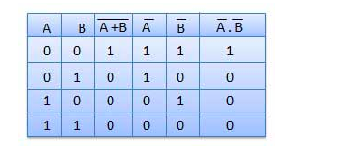
Table showing verification of the De Morgan's second theorem −

Slide 37
Solve this
Apply DeMorgan's theorems to each of the following expressions:
(a) (A + B + C)’D’
(b) (ABC + DEF )’
(c) (AB)’ + (CD)’ + (EF )’

Slide 38
Design a logic circuit using basic logic gates.
Y= AB + A’ B
Z= A’BC + ABC + A’B’C’ + AC
P = A’B’C’D + ABCD + A’BC’D

Slide 39
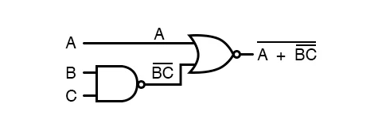
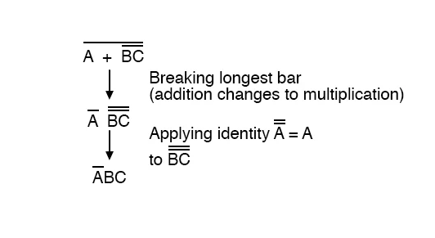
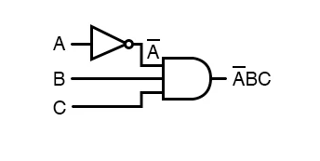
Let’s take the expression (A + (BC)’)’ and reduce it using De Morgan’s Theorems:

Slide 40
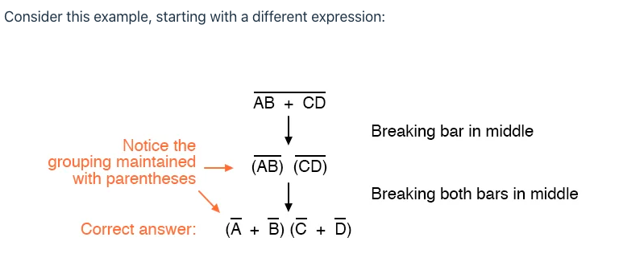

Slide 41
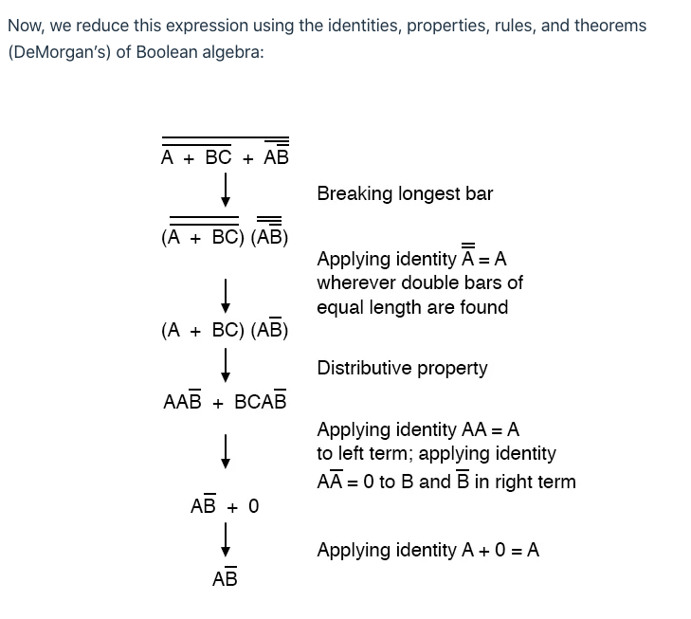
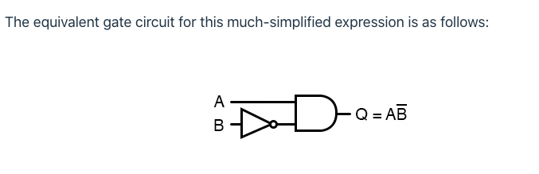

Slide 42
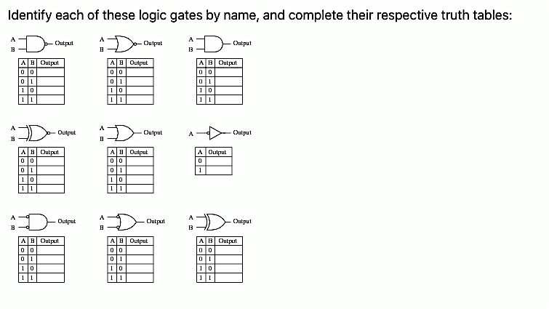

Slide 43
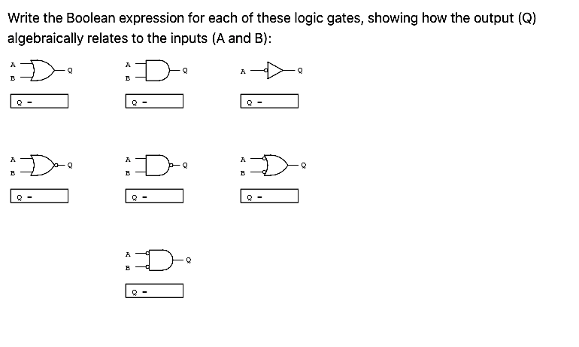

Slide 44
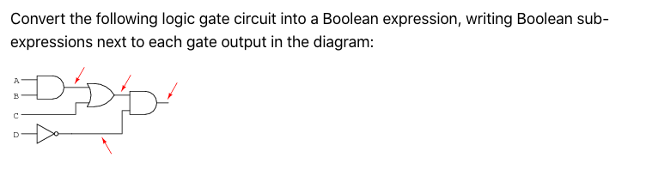
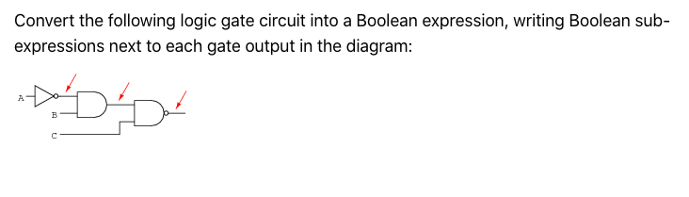

Slide 45
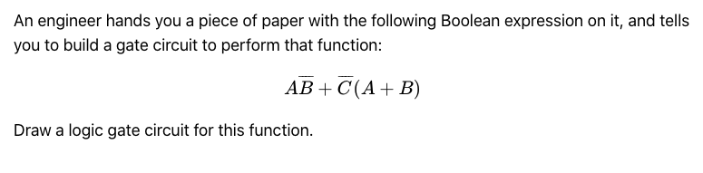


Slide 46
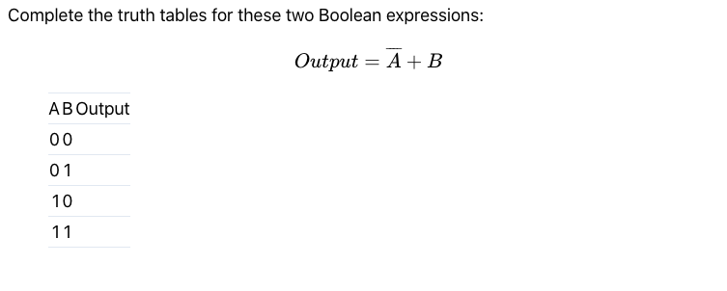
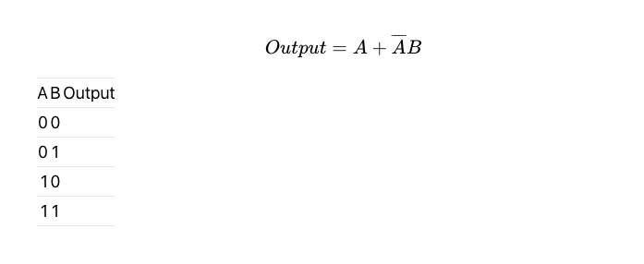

Slide 47
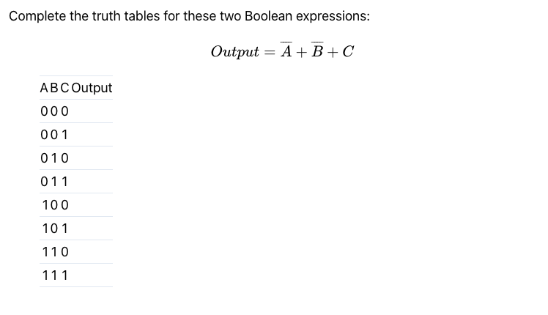

Slide 48
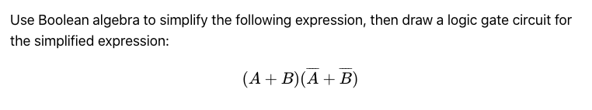
Simplify using Boolean laws
AB + B(B + C’) + BC’
C’F + F(A +B’) + C’
AB + A(B + C) + B(B + C)

Slide 49
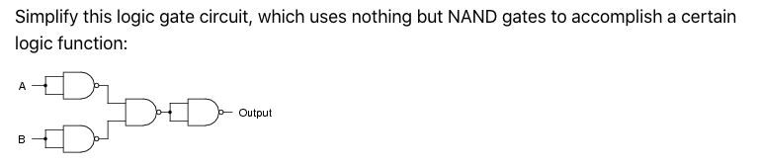
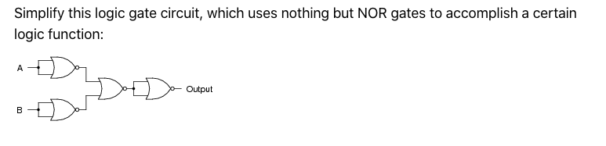

Slide 50
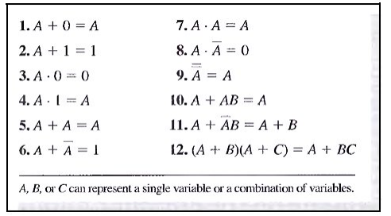

Slide 51
Prove:
A + A’B = A + B
A+ AB = A
(A + B)(A + C)=A + BC

Slide 52
